Slide 1
Sales Analysis and Prediction Models
Created by: James Peebles

Slide 2
Overview
Meeting Objective
To help the retailer understand the properties of products and outlets that play crucial roles in predicting sales
Meeting Goals
Discuss visualizations with analyses
Provide recommendations for stakeholders

Slide 3
Assumptions
Data has been cleaned
Data has been refreshed and represents the latest data available
Standard caveats existing in sales data and the audience has some familiarity with the products being discussed.

Slide 4
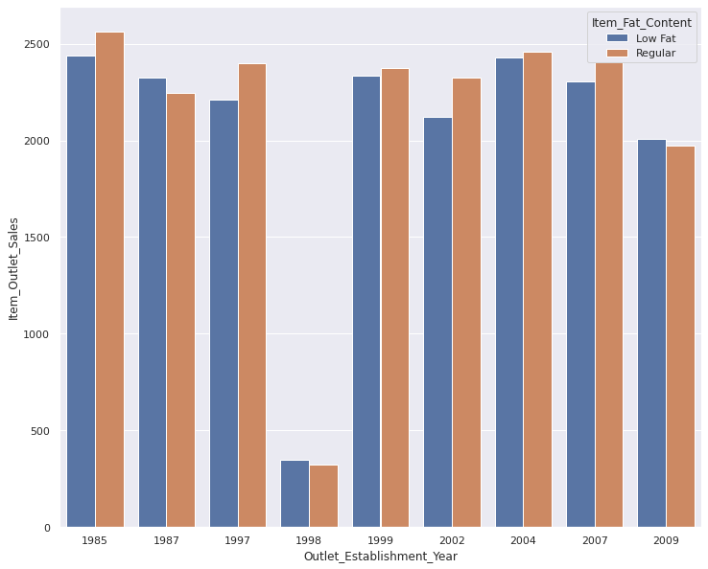
Fat Content Sales by Year
ANALYSIS:
Low Fat and Regular fat content sales are relatively consistent across the years
Further analysis needed for sharp decline in 1998 to prevent repeat
Sales of these items have yet to cross the 3000 threshold. How can we can take sales to the next level?

Slide 5
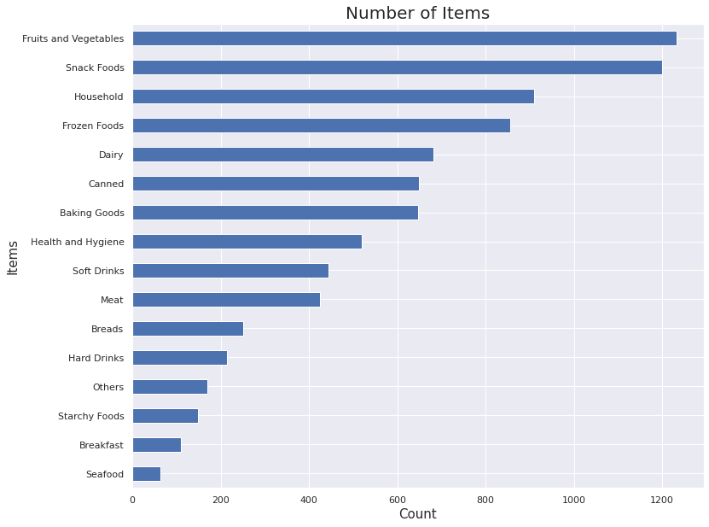
Analysis of Items Sold
ANALYSIS:
Food items are selling well whether they are healthy or not as observed earlier
Food items are the top sellers
Seafood, Breakfast and Starchy Foods are bringing up the rear in sales
A majority of the items fall below the 600 count threshold.

Slide 6
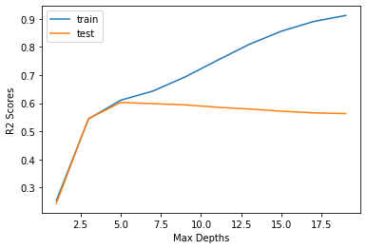
Model Analysis
ANALYSIS:
After tuning and testing different models we settled upon Random Forest model
Found the best fit at a Max Depth of 5
Minimal variance and bias

Slide 7
Recommendations
Investigate events occurring in 1998 that triggered the sharp drop in sales
Consider investing additional marketing funds in Seafood or remove it as an item if sales continue as they are.
Utilize the Random Forest model for the best fit on your data
Continue to concentrate on food items as they are the strongest item

